Slide 1
CLAS12 Simulations
Maurizio Ungaro
JLAB

Slide 2
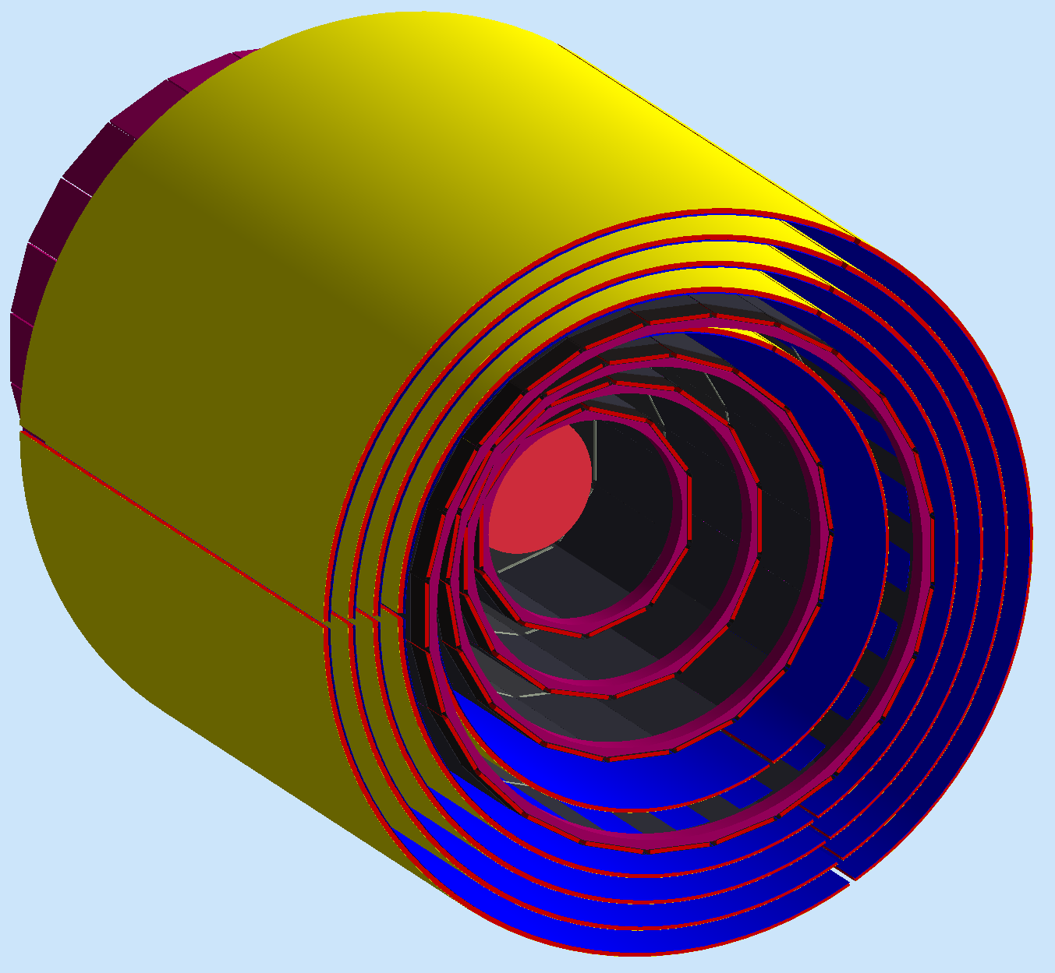
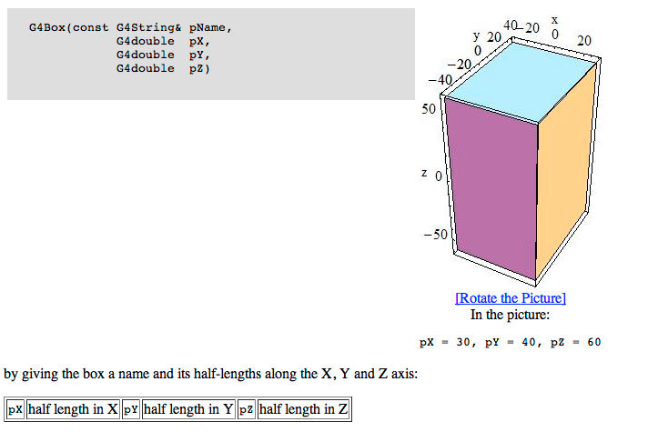
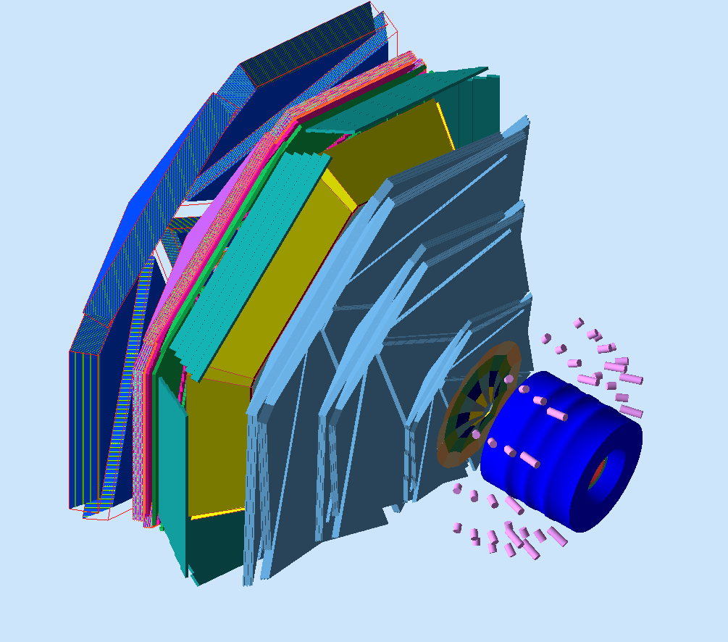
Using Geant4 calls directly is problematic
Thousands of detector elements
Each number is hardcoded: geometry, sensitivity, etc:
Development, Debugging, Distribution Nightmare
Are we using the same numbers in reconstruction?

Slide 3
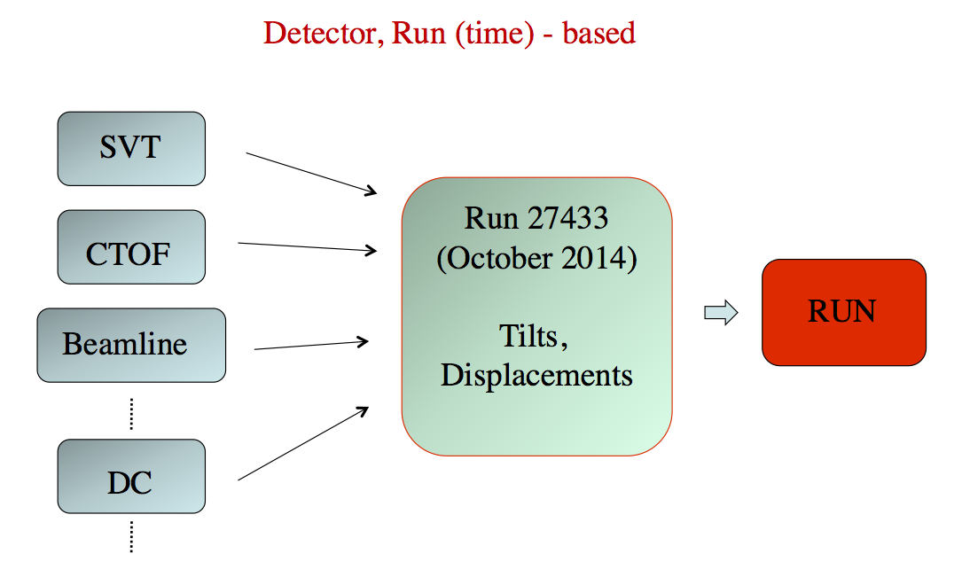
Solution: all parameters EXTERNAL to the code
Database
(MYSQL, GDML,
CLARA)
The Geometry
Sensitivity
Digitization
Output Format
Magnetic Fields
Materials
Now the parameters are all external. No hardcoded numbers, selectable source.
We can use the same numbers in reconstruction!

Slide 4
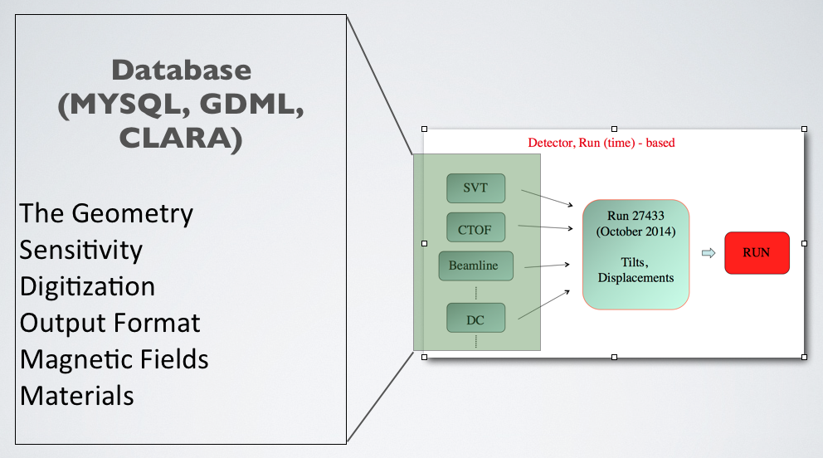
GEant4 Monte-Carlo (GEMC)
Object Oriented Approach
c++ classes, Standard Template Library
Simulation Parameters are External to Software
Geometry, Materials, Parameters, Sensitivity, Fields, Banks
Run-Time decisions on step, Output Format, Parameters Factory, etc
Notes:
GEMC is a software framework that interfaces with the GEANT4 libraries.
It is driven by two design principles:
Number 1: Use Object Oriented design that includes the c++ Standard Template Library.
The geant4 solid, logical physical volumes, magnetic fields, sensitivities, etc are abstracted into general classes that can be built from the database of user choice.
For example, one can use MYSQL, GDML or CLARA to define the geometry.
Number 2: All simulation parameters must stored external to the code, stored in an external database. In other words, there are no hardcoded numbers in gemc.
In fact gemc is agnostic on the detector: choosing what configuration to use is a matter of choosing what database to use, a choice that can be done trivially at run time.

Slide 5
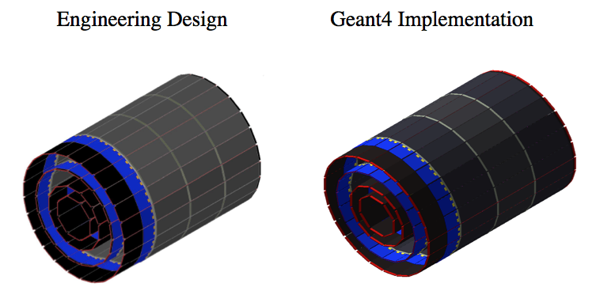
GEMC Features
1) No Hardcoded Numbers
Realistic Geometry
No Recompiling
At run-time: tilt, displacements, step sizes, fields, etc
Notes:
Let’s go through the main GEMC features.
The users do not need to know any c++ or geant4 for that matter to build detectors. A simple API takes care of the database I/O.
So users can – and did - concentrate on making the geometry as realistic as possible.
Upon database upload, which is instantaneous, the geometry is available to all users - literally across the globe - w/o having to recompile the code,
or even downloading files. Users in French want to upload their micromegas
geometry: they click a button and everybody sees it at once.
Many additional parameters are selectable at run time: displacements, step size, magnetic field scaling, physics list to use, luminosity options etc.
All these decisions are made either by command line or configuration file.

Slide 6
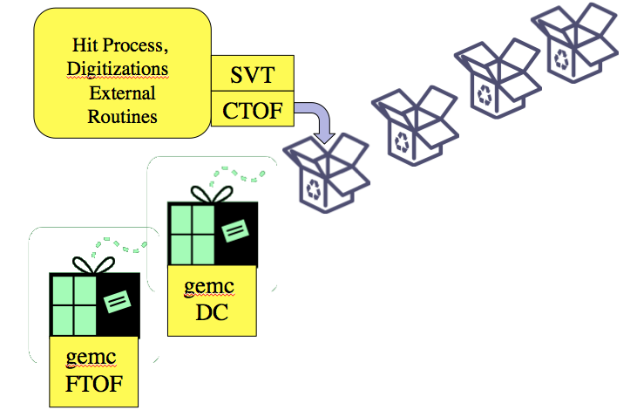
GEMC Features
1) No Hardcoded Numbers
Realistic Geometry
No Recompiling
At run-time: tilt, displacements, step sizes, fields, etc
2) Flexible, Maintainable Code. Cross Platform.
User selection of routines (plugins) at run time
Windows, Mac, Linux
Used in several experiments
Notes:
Due to a religious object oriented implementation, the code is flexible, easy to extend and debug. It is also cross platform.
The use of pure virtual abstract classes allow to select desired routines at run time.
For example, users can decide to load the material parameters from a CPP file. Or from a MYSQL database.
They can decide the input or output format.
In this framework the available choices for these various subsystems can be trivially extended.
Since the software is detector agnostic, the same code is used not just for CLAS12 but for other experiment as well.

Slide 7
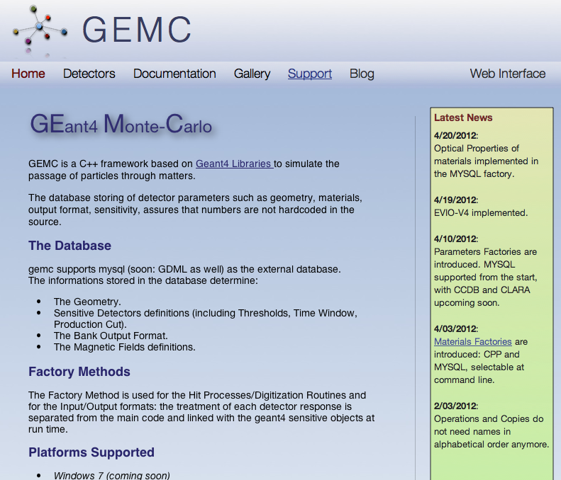
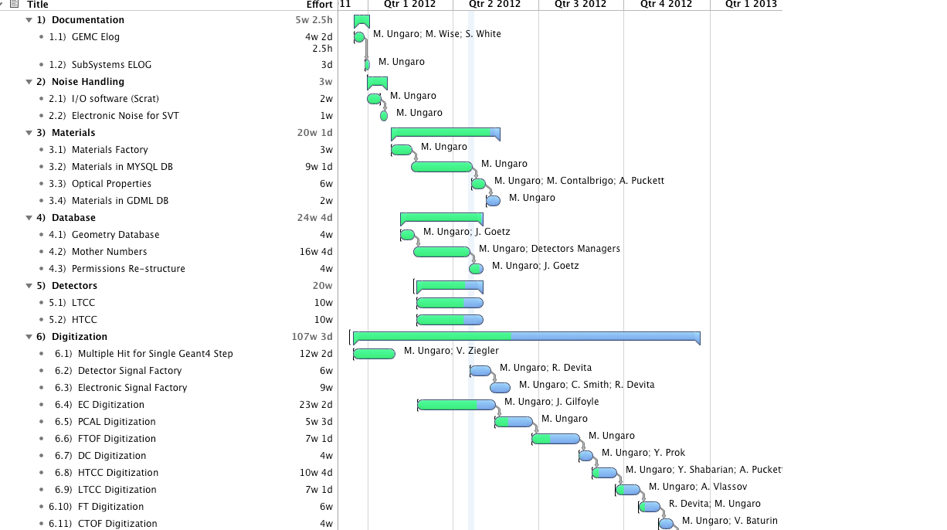
GEMC Features
1) No Hardcoded Numbers
Realistic Geometry
No Recompiling
At run-time: tilt, displacements, step sizes, fields, etc
2) Flexible, Maintainable Code. Cross Platform.
User selection of routines (plugins) at run time
Windows, Mac, Linux
Used in several experiments
3) Documentation
Doxygen
Mantis Bug Report / Feature Request
Timeline, Software Management
gemc.jlab.org, mailing list, blog
Notes:
Documentation:
Gemc uses doxygen; that documentation is generated nightly. Classes and method are defined inline and described in details.
Gemc makes extensive use of Mantis, a web based Bug/Features request system. Bugs are tracked, solutions and debugging are logged, all the conversation is automatically sent by email to the interested parties.
The project timeline uses the Omniplan software. Resources are allocated, projects are assigned with duration time. Milestone are managed.
The software is released on the subversion repository, and it is maintained and tested across several platform. M. Ungaro, the author of the code, supervise all aspects of development and has in place code validation and testing. Some runs every 15 minutes, some daily. For example, if a change is introduced that will not cause compilation error for a particular platform, his pager will alarm!
All of this is kept on the gemc website, that also store howtos, tutorials, quick guides, step by step installation guides. We invite you to visit this website.

Slide 8
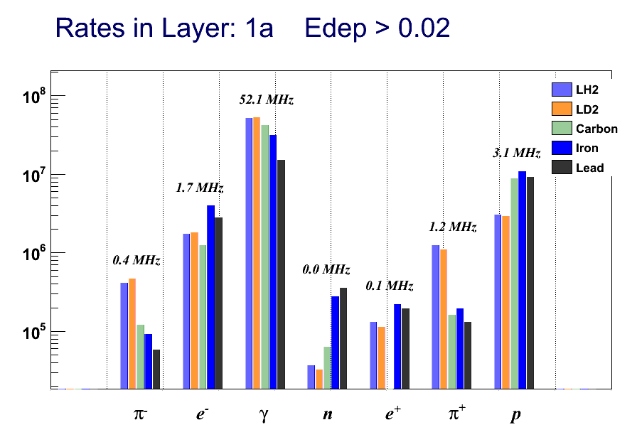
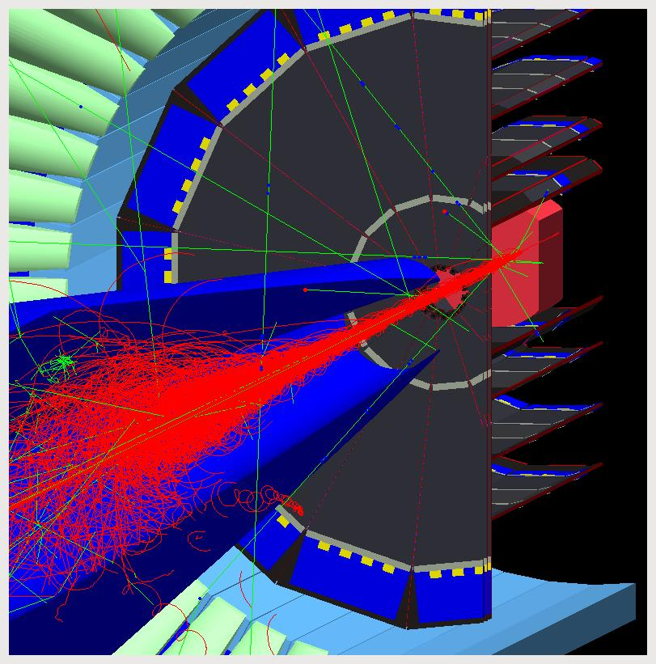
Background Rates, Radiation Doses
Layer GeV/s GeV/(s cm²) mrads/s mrads/(s cm²) rad/year rad/(year cm²)
1a 7147.8 19.05 4.39 0.011708 138480 369.24
1b 3889.4 10.37 2.38 0.006371 75352 200.92
2a 4578.2 4.06 0.93 0.000833 29566 26.27
2b 3551.7 3.15 0.72 0.000646 22936 20.38
3a 3828.5 1.51 0.34 0.000137 10988 4.34
3b 3295.7 1.30 0.29 0.000118 9459 3.73
4a 3145.5 0.93 0.21 6.360e-05 6771 2.00
4b 2743.3 0.81 0.18 5.547e-05 5905 1.74
Notes:
Gemc has been used for several years to validate and assist the CLAS12 engineering design.
For example, this is a picture of the the clas12 central detector simulation operating at about 1/10 of the nominal luminosity. You can see the sausage of moeller electrons contained in a moeller shield.
GEMC has been run at the full luminosity to calculate the background rate for different particles and several targets. You can see an example of that on the top-right plot.
These results are crucial in order to make sure that the electronics can handle the CLAS12 luminosity
Furthermore, gemc has been used to calculate the energy flux and the radiation doses in various part of the detector. An example of that, for the barrel silicon vertex, is shown on this table.

Slide 9
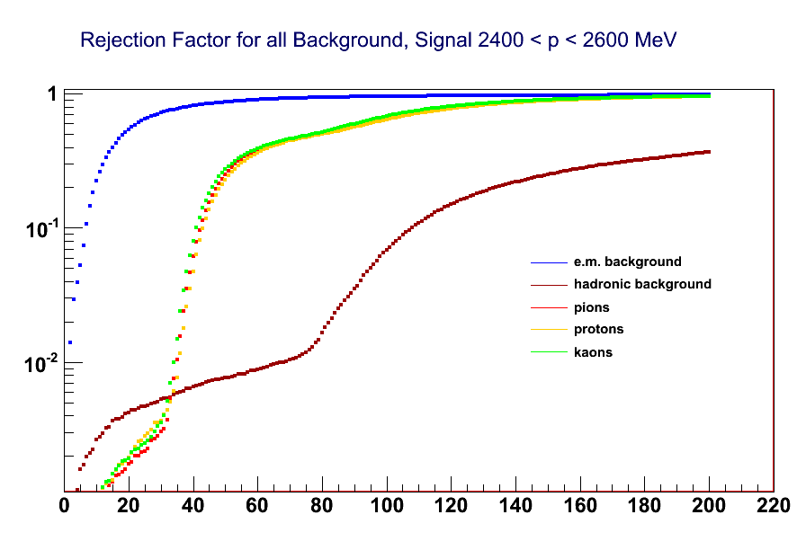
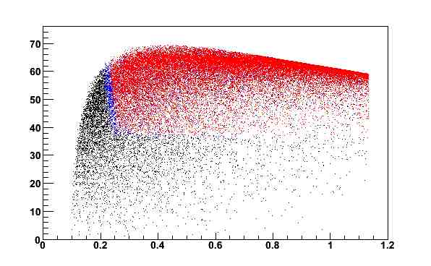
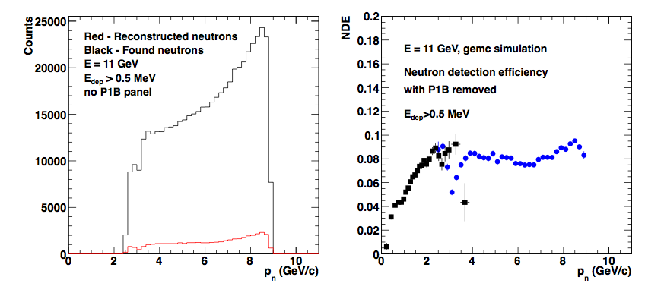
Acceptance, Detector Responses
deg
Barrel
Silicon
Tracker
Generated Events
3 or more SL
4 SL
GeV
KeV
Forward
Time-of-Flight
Notes:
You can see on top left the acceptance of proton in the central silicon tracker. A cutoff at 300 MeV for Protons is shown: protons of very low momentum are loopers in the magnetic field.
On the top right is the rejection factor as a function of energy threshold for signal and background. This drives the choice of threshold in the electronics, which in turn determines how much background - and noise - we’ll get in the data acquisition.
At the bottom there’s the reconstruction efficiency for simulated neutrons in the forward time of flight. On the left, the black curve is the neutrons that hit the TOF, and red are the reconstructed, as the function of neutron momenta. The ratio is shown, in blue, on the right, compared with measurement with the lower energy clas6 detector. The dip is due to a small gap between TOF panels.

Slide 10
Feature Presentation
This movie shows the actual CLAS12 GEMC simulation
Detectors’ volumes turned on one by one
Digitized signals are shown
Notes:
We figured that the best way to describe the implementation of ALL the clas12 detectors, their response functions and digitization in a short time is… to show it to you.
So we made a movie where we turned on the geant4 volumes one by one, to give it a “construction” feeling. Then we ran some charged tracks.
Near the end, the GUI is shown with digitized signals. You will see, for each geant4 step, the drift chambers energies and timing, the cerenkov detected photons as a function of their wavelength, the energy deposited in the calorimeters. All of that, color coded by particle type.
So this is what comes next.

Slide 11
M. Ungaro

Slide 12
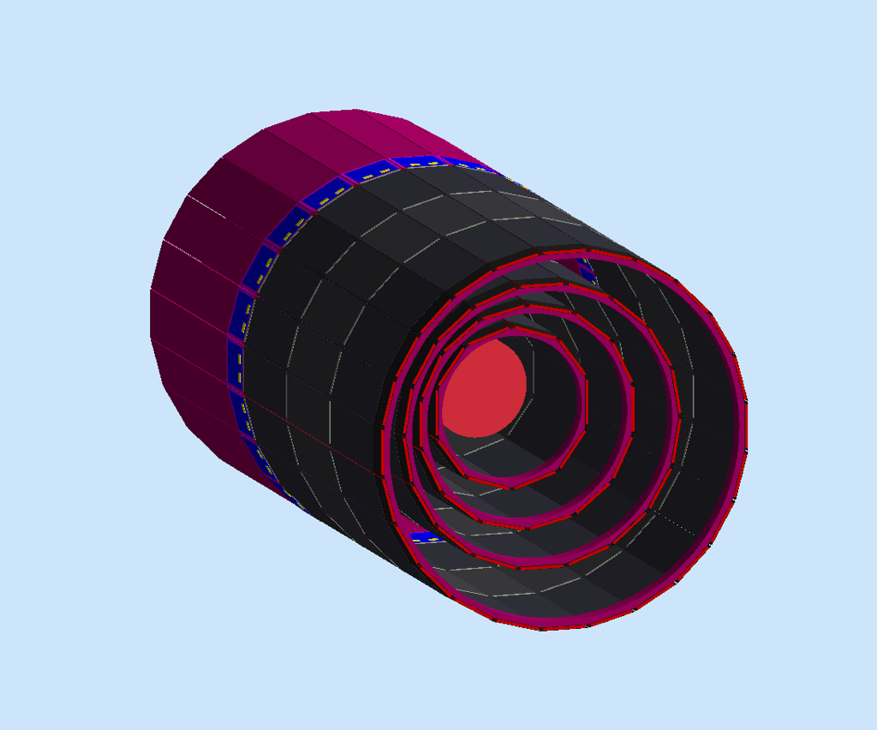
BST
Geometry: Complete
Sensitivity: 3 or 4 regions, 2 layers/reg, 3 modules/lay, 256 variable angle strips /lay. Charge Sharing, Electronic Noise.
Digitization: 3 bit ADC, region/layer/strip #
Time Window: 130 ns
3 or 4 Regions
2 Layers Each Region
3 Modules each Layer
256 Strips each Layer
Resources:
Maurizio Ungaro
Amrit Yegneswaran
Yuri Gotra

Slide 13
BMT/FMT
Geometry: Complete
Sensitivity: 3 or 4 regions, 2 layers/reg, 3 tiles/lay, 1000 strips /tiles. Charge Sharing, Lorentz Angle.
Digitization: 12 bit ADC, region/layer/tiles/strip #
Time Window: 100 ns
3 or 4 Regions
2 Layers Each Region
3 Tiles each Layer
Resources:
Sebastien Procureur
Gabriel Charles

Slide 14
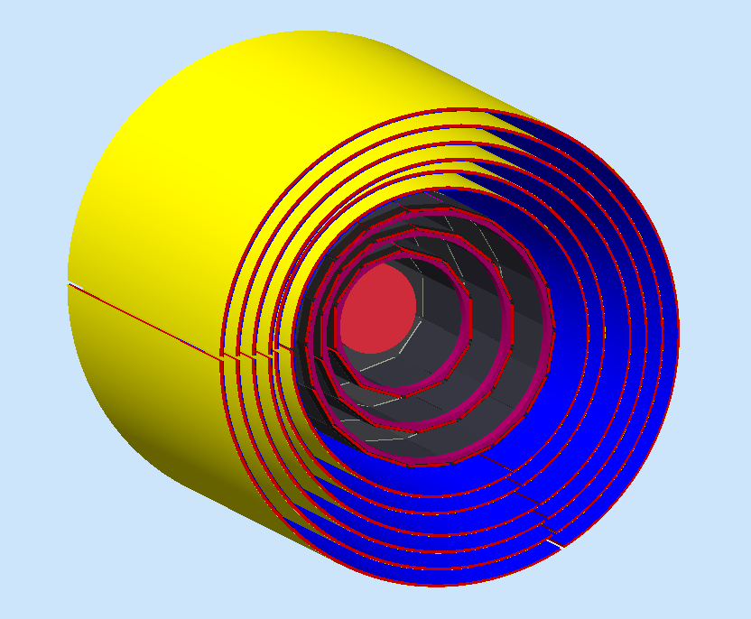
Barrel Tracker
Geometry: Complete
Sensitivity (BST): 3 or 4 regions, 2 layers/reg, 3 modules/lay, 256 variable angle strips /lay. Charge Sharing, Electronic Noise.
Sensitivity (BMT): 3 or 4 regions, 2 layers/reg, 3 tiles/lay, 1000 strips /tiles. Charge Sharing, Lorentz Angle.
Digitization (BST): 3 bit ADC, region/layer/strip #
Digitization (BMT): 12 bit ADC, region/layer/tiles/strip #
Time Window: 132 (BST)/100 (BMT) ns
Resources:
3 BST Regions, 2 SL each
3 BMT Regions, 2 SL each
Sebastien Procureur
Gabriel Charles
Maurizio Ungaro
Amrit Yegneswaran
Yuri Gotra

Slide 15
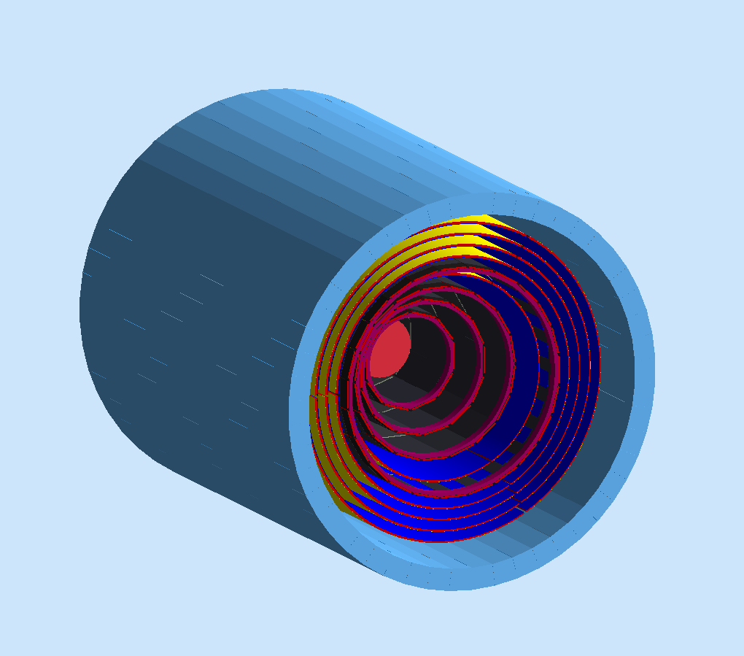
CTOF
Geometry: Complete
Sensitivity: 58 scintillators , (photo-sensor quantum efficiency, attenuation length, effective velocity*).
Digitization: Paddle #, (ADC, TDC*)
Time Window: 4 ns
56 Scintillators
70 ns resolution
Resources:
Maurizio Ungaro
Vitaly Baturin
* In progress

Slide 16
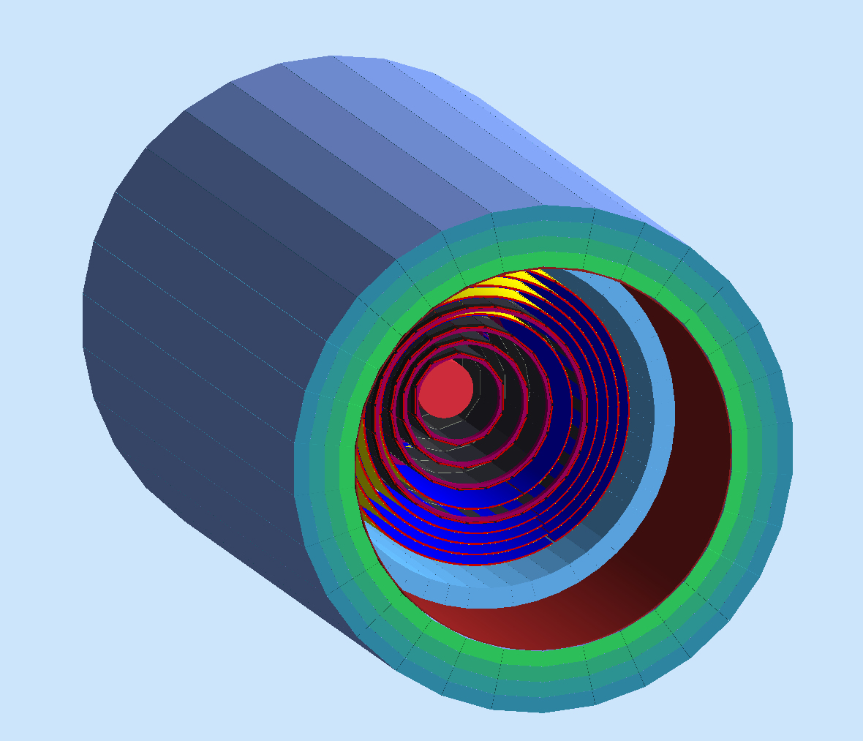
CND
Geometry: Complete
Sensitivity: 3 or 4 layers, 48 scintillators each, photo-sensor quantum efficiency, attenuation length, effective velocity, Birks Effect, paddle resolution
Digitization: Region, Paddle #, ADC, TDC
Time Window: 4 ns
Resources:
3 or 4 layers
48 scintillators each
Silvia Niccolai
Daria Sokhan

Slide 17
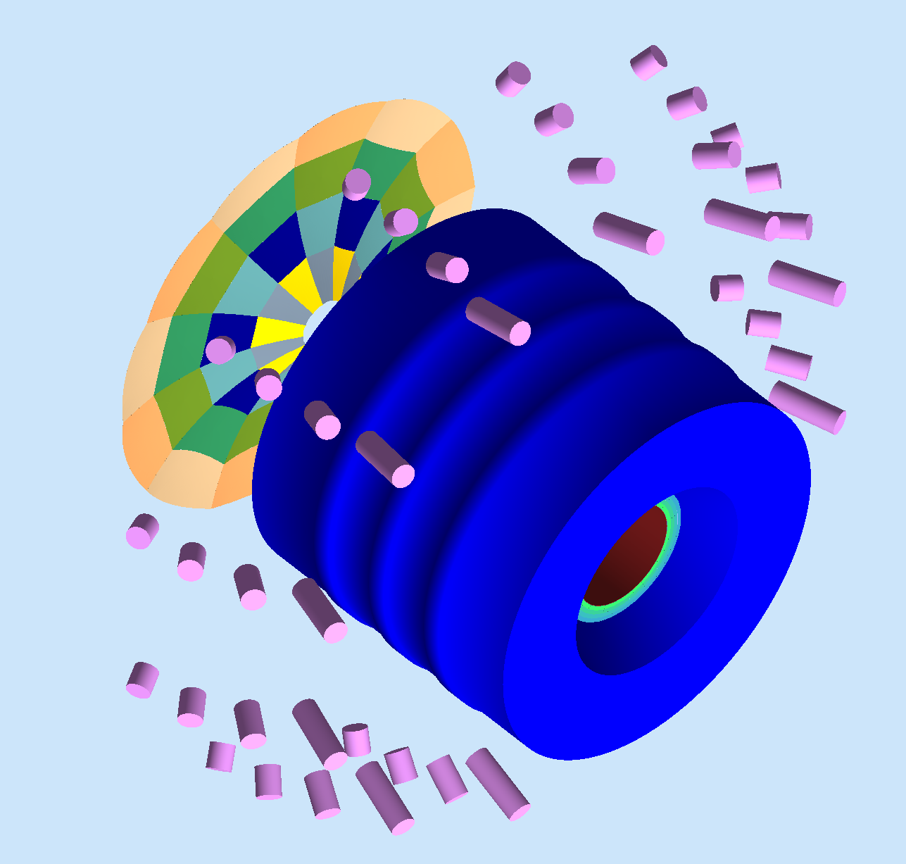
HTCC
Geometry: Complete
Sensitivity: 12 sectors, 4 layers. Wavelength-dependent PMT quantum efficiency and gas, mirrors refraction indexes.
Digitization: PMT#, ADC, TDC
Time Window: 100 ns
Resources:
4 Layers of Mirrors
12 Sectors of Mirrors
48 PMTS, WC
Nathan Harrison
Youri Sharabian
Maurizio Ungaro
Andrew Puckett

Slide 18
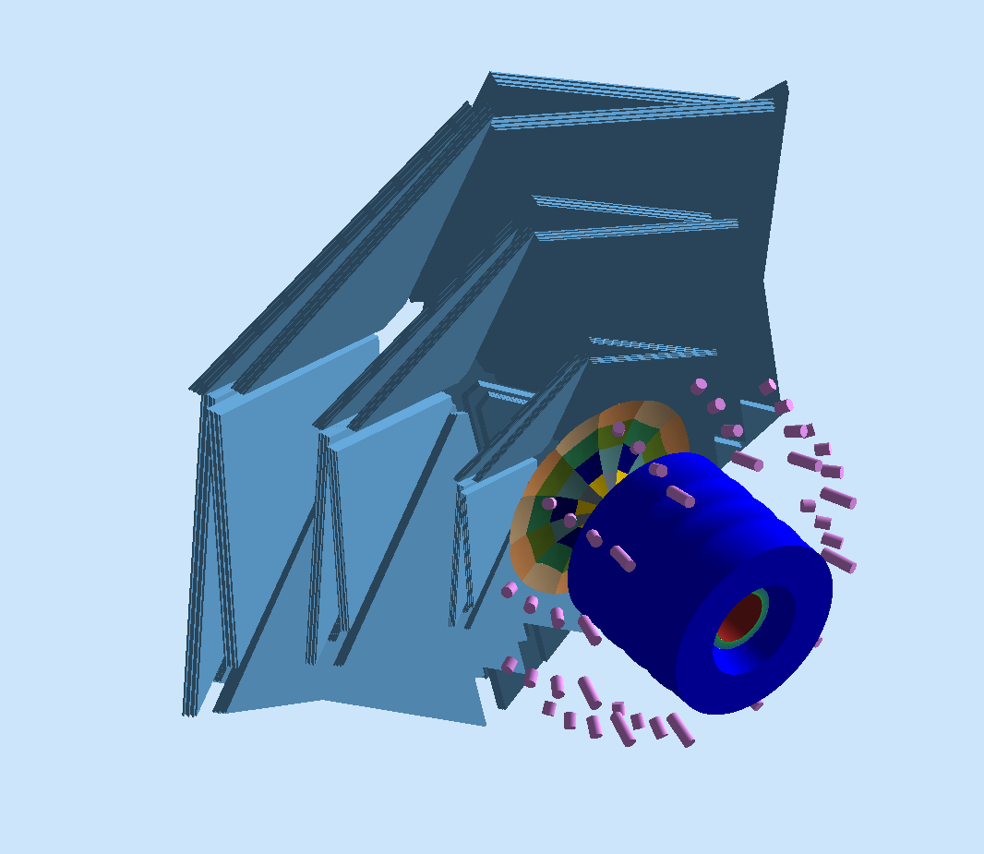
DC
Geometry: Complete
Sensitivity: 3 regions 2 Superlayers/reg 6 layers/SL. DOCA, drift velocity, cell resolution..
Digitization: Sector, Region, SL, L, wire #, (ADC, TDC*)
Time Window: 250, 500 ns
3 Regions of DC
2 SL Each Region
6 Layers Each SL
112 Sensitive Wires each Layer
Resources:
Mac Mestayer
Yelena Prok
* In progress

Slide 19
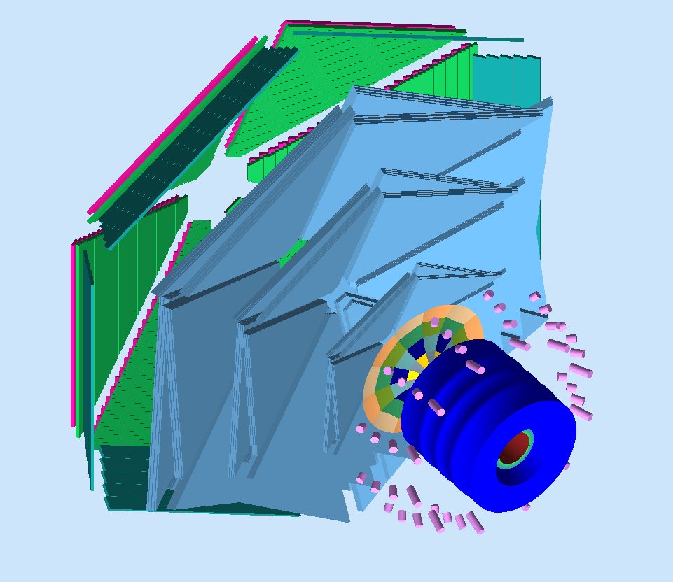
FTOF
Geometry: Complete
Sensitivity: 3 panels, 5, 56, 120 paddles. photo-sensor quantum efficiency, attenuation length, effective velocity*
Digitization: Sector, Panel, PMT#, ADC, TDC
Time Window: 4 ns
Resources:
3 Layers of TOF
5, 56, 112 Paddles
Dan Carman
Maurizio Ungaro
* In progress

Slide 20
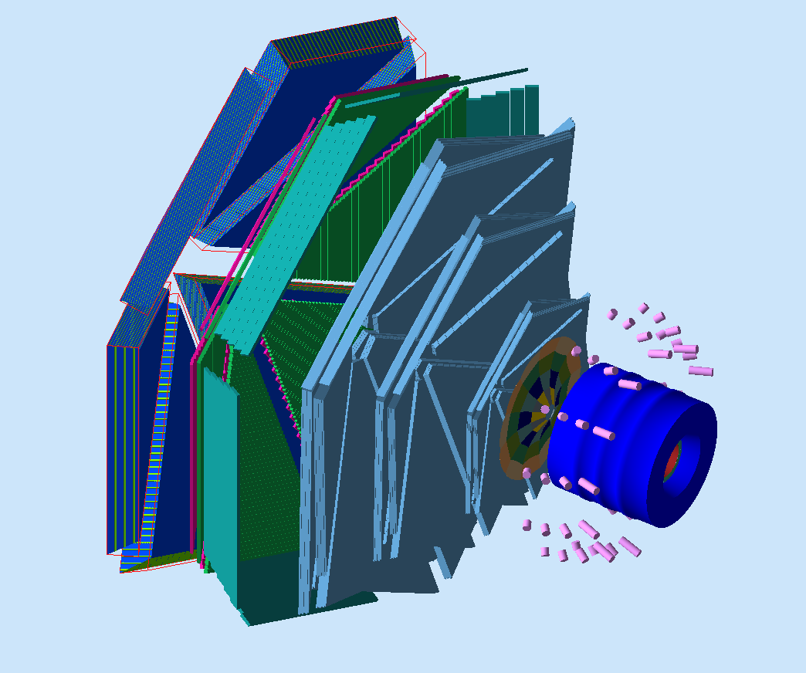
EC
Geometry: Complete
Sensitivity: 39 layers, u, v, w view, 36 scintillators, (attenuation length, effective velocity*), PMT gain, number of photons/charge
Digitization: Sector, stack, view, strip, ADC, TDC
Time Window: 200 ns
Resources:
39 layers/sector, 1296 channels
Jerry Gilfoyle
* In progress

Slide 21
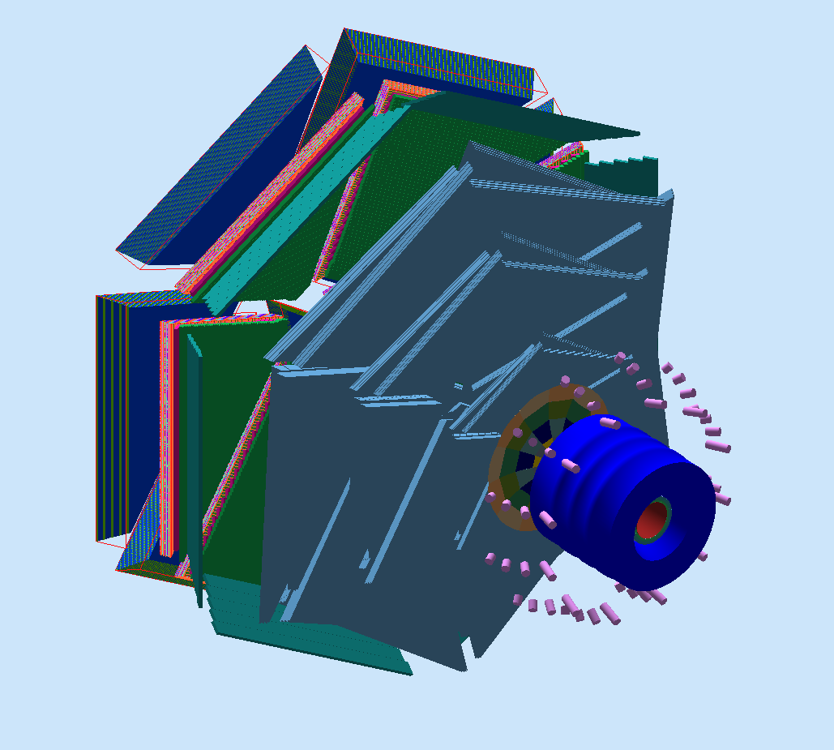
PCAL
Geometry: Complete
Sensitivity: 15 layers, u,v,w views, 24 scintillators/view , attenuation length, effective velocity, PMT gain, number of photons/charge
Digitization: Sector, stack, view, strip, ADC, TDC
Time Window: 200 ns
Resources:
27 layers/sector, 1152 channels
Mike Wood
Alex Piaseczny
Jerod Sikorskyj

Slide 22
RICH
Geometry: Complete
Sensitivity: Wavelength-dependent PMT quantum efficiency and gas, mirrors refraction indexes. Multi-channel PMT
Digitization: Multi-channel PMT#, ADC, TDC
Time Window: 130 ns
Resources:
Ring Imaging Cherenkov
Marco Contalbrigo
Luciano Pappalardo
Patrizia Rossi
Nathan Baltzell
Alaoui Ahmed

Slide 23
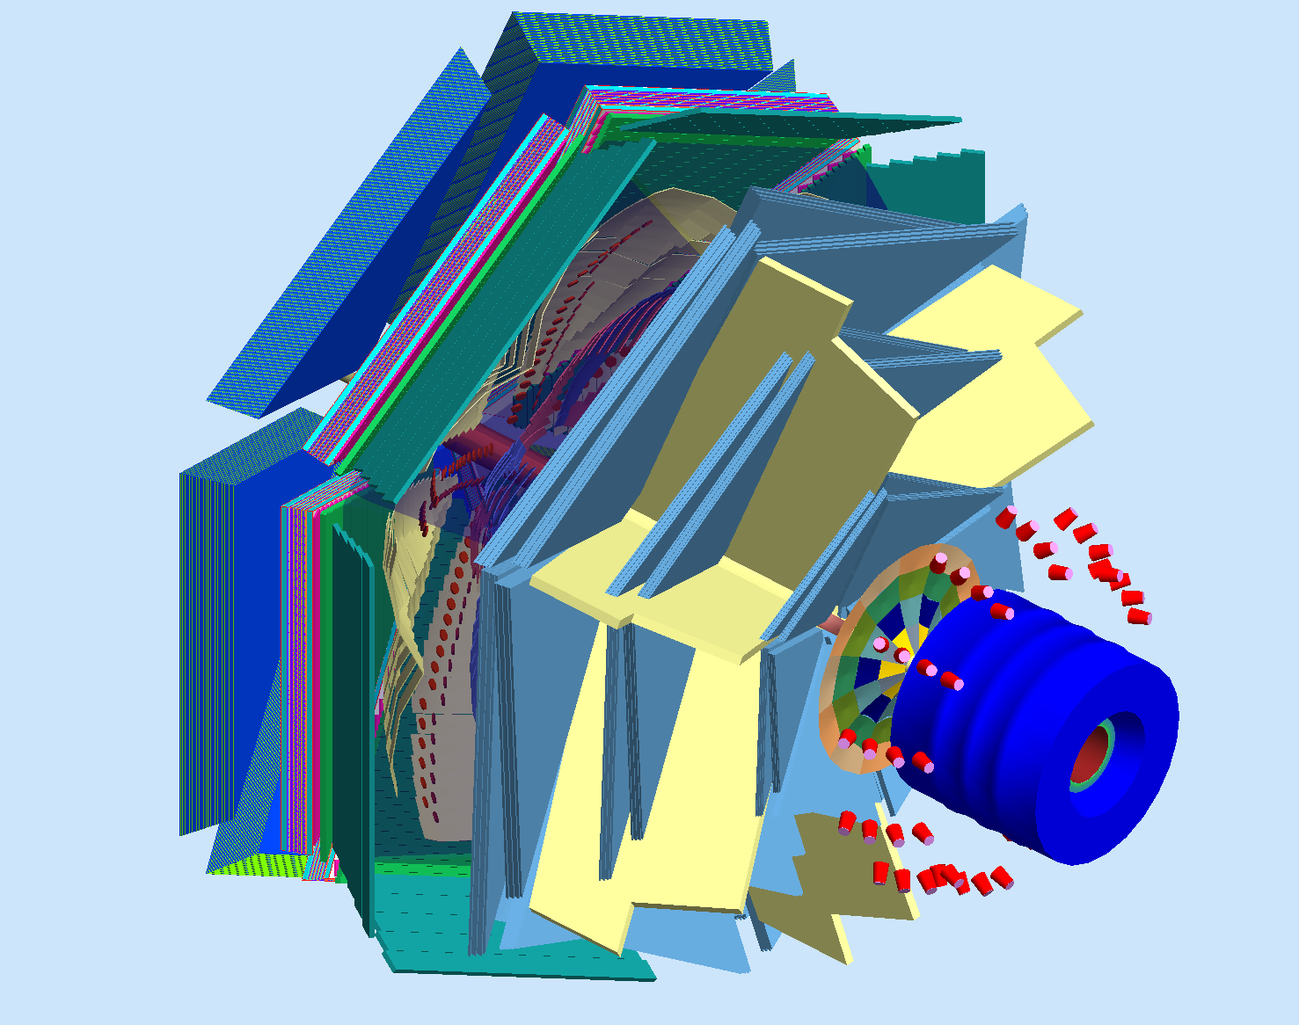
LTCC
Geometry: Complete
Sensitivity: 36 elliptical, 36 hyperbolical mirrors, WC*, PMT. (Wavelength-dependent PMT quantum efficiency and gas, mirrors refraction indexes*). Number of photoelectrons and timing.
Digitization: Sector, PMT# L/R, (ADC, TDC*)
Time Window: 130 ns
Resources:
36 elliptical, 36 hyperbolical mirrors, UV PMTs
M. Ungaro
Alex Vlassov
* In progress

Slide 24
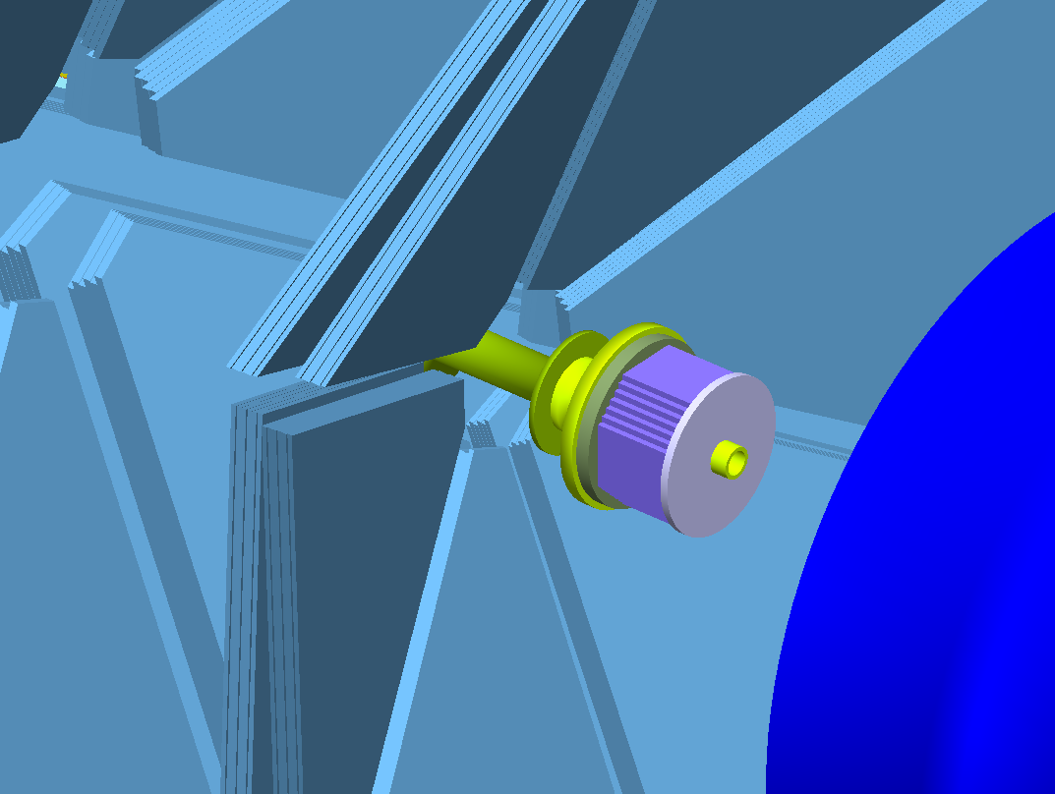
FT
Geometry: Complete
Sensitivity: Light Yield for PbWO4, APD Quantum Efficiency, gain, noise.
Digitization: PMT#, ADC, TDC
Time Window: 132 ns
Resources:
PbWO4 Scintillators
R. DeVita

Slide 25
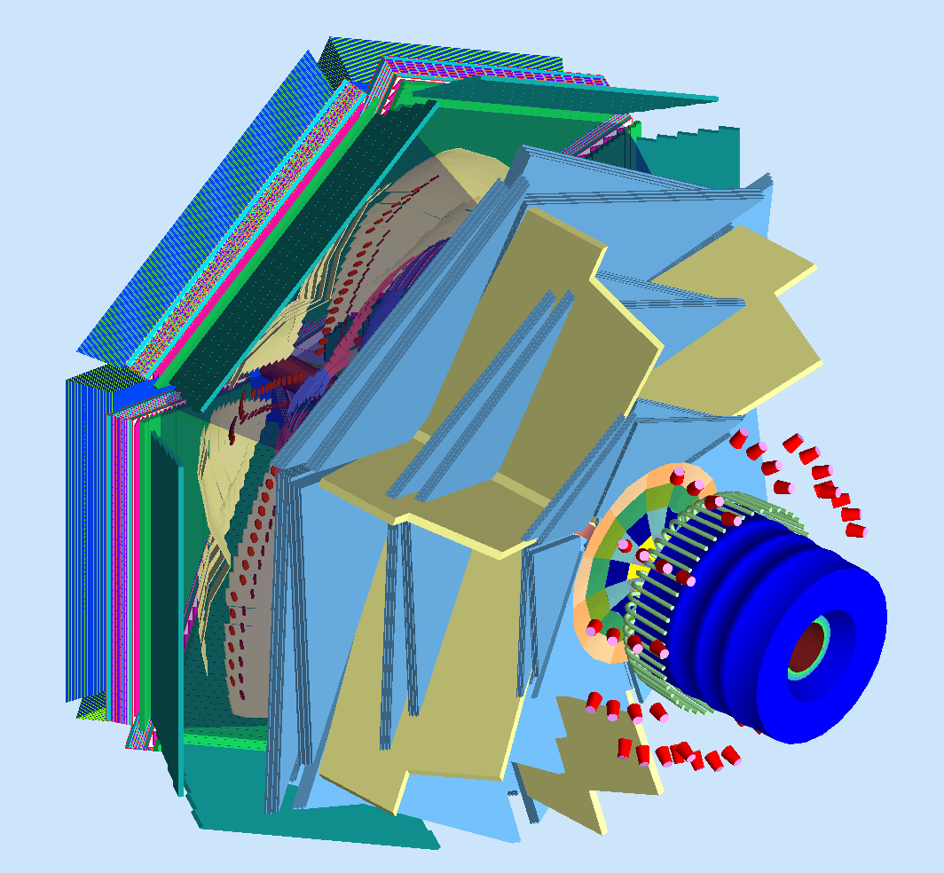
The CLAS12 Detector
PCAL
FTOF
EC
LTCC
DC
Central Detector
BST, BMT, FMT,
CTOF, CND
HTCC

Slide 26
GEant4 Monte-Carlo (GEMC)
Object Oriented Design
c++ classes, Standard Template Library
Includes the complete CLAS12 base line
Includes all detectors upgrades to CLAS12
In use since 2007 for:
input for detector design and optimization
event reconstruction
high level physics analysis
beam background
No hardcoded numbers: geometry, digitization from database

Slide 27
GEant4 Monte-Carlo (GEMC)
Object Oriented Design
c++ classes, Standard Template Library
Includes the complete CLAS12 base line
Includes all detectors upgrades to CLAS12
In use since 2007 for:
input for detector design and optimization
event reconstruction
high level physics analysis
beam background
No hardcoded numbers: geometry, digitization from database
PCAL
FTOF
EC
LTCC
DC
Central Detector
BST, BMT, FMT,
CTOF, CND
HTCC

Slide 28
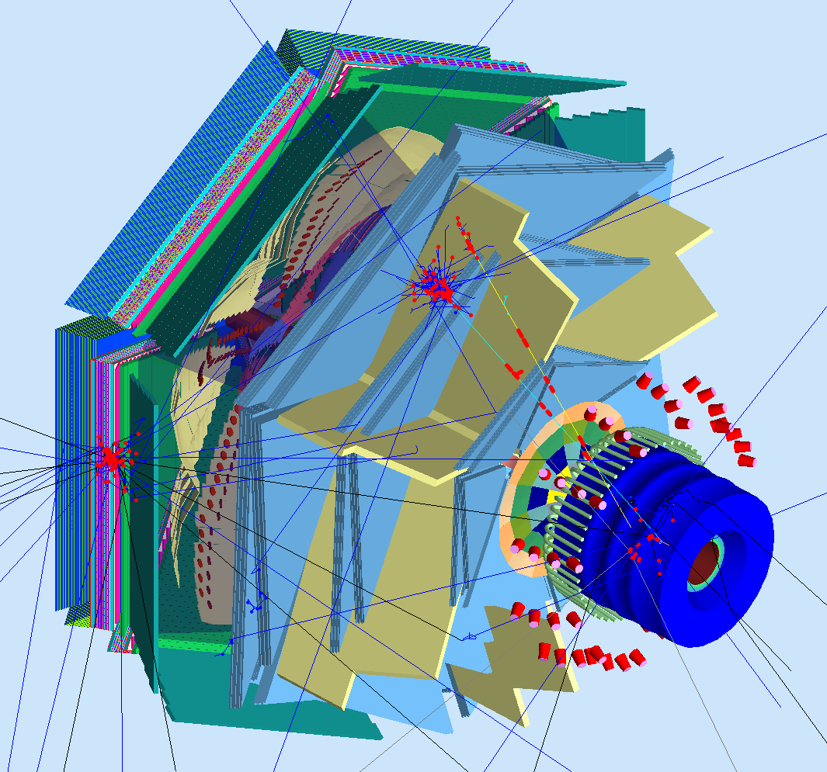
GEant4 Monte-Carlo (GEMC)
Object Oriented Design
c++ classes, Standard Template Library
Includes the complete CLAS12 base line
Includes all detectors upgrades to CLAS12
In use since 2007 for:
input for detector design and optimization
event reconstruction
high level physics analysis
beam background
No hardcoded numbers: geometry, digitization from database

Slide 29
GEant4 Monte-Carlo (GEMC)
Object Oriented Design
c++ classes, Standard Template Library
Includes the complete CLAS12 base line
Includes all detectors upgrades to CLAS12
In use since 2007 for:
input for detector design and optimization
event reconstruction
high level physics analysis
beam background
No hardcoded numbers: geometry, digitization from database
PCAL
FTOF
EC
LTCC
DC
Central Detector
BST, BMT, FMT,
CTOF, CND
HTCC

Slide 30
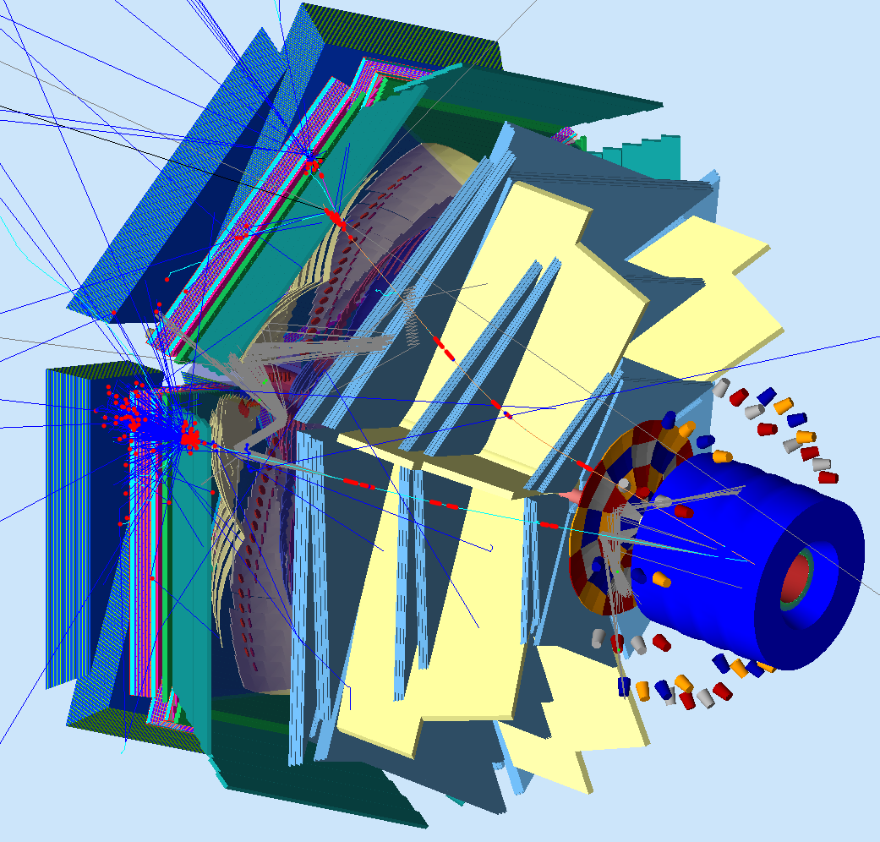
GEant4 Monte-Carlo (GEMC)
Object Oriented Design
c++ classes, Standard Template Library
Includes the complete CLAS12 base line
Includes all detectors upgrades to CLAS12
In use since 2007 for:
input for detector design and optimization
event reconstruction
high level physics analysis
beam background
No hardcoded numbers: geometry, digitization from database
PCAL
FTOF
EC
LTCC
DC
Central Detector
BST, BMT, FMT,
CTOF, CND
HTCC

Slide 31
Sensitivity/Digitization
Detector | Sensitivity | Digitization | Time Window
BST | 3 or 4 regions, 2 layers/reg, 3 modules/lay, 256 variable angle strips /lay. Charge Sharing, Electronic Noise. | 3 bit ADC, region/layer/strip # | 130 ns
BMT/FMT | 3 or 4 regions, 2 layers/reg, 3 tiles/lay, 1000 strips /tiles. Charge Sharing, Lorentz Angle. | 12 bit ADC, region/layer/tile/strip # | 130 ns
CTOF | 58 scintillators , (photo-sensor quantum efficiency, attenuation length, effective velocity*) | Paddle #, (ADC, TDC*) | 4 ns
CND | 3 or 4 layers, 48 scintillators each, photo-sensor quantum efficiency, attenuation length, effective velocity, Birks Effect, paddle resolution | Region, Paddle #, ADC, TDC | 4 ns
HTCC | 12 sectors, 4 layers. Wavelength-dependent PMT quantum efficiency and gas, mirrors refraction indexes. | PMT#, ADC, TDC | 100 ns
DC | 3 regions 2 Superlayers/reg 6 layers/SL. DOCA, drift velocity, cell resolution. | Sector, Region, SL, L, wire #, (ADC, TDC*) | 250, 500 ns
LTCC | 36 elliptical, 36 hyperbolical mirrors, WC*, PMT. (Wavelength-dependent PMT quantum efficiency and gas, mirrors refraction indexes*). Number of photoelectrons and timing. | Sector, PMT# L/R, (ADC, TDC*) | 100 ns
FTOF | 3 panels, 5, 56, 120 paddles. photo-sensor quantum efficiency, attenuation length, effective velocity* | Sector, Panel, PMT#, ADC, TDC | 4 ns
PCAL | 15 layers, u,v,w views, 24 scintillators/view , attenuation length, effective velocity, PMT gain, number of photons/charge | Sector, stack, view, strip, ADC, TDC | 200 ns
EC | 39 layers, u, v, w views, 36 scintillators/view, attenuation length, effective velocity, PMT gain, number of photons/charge | Sector, stack, view, strip, ADC, TDC | 200 ns
RICH | Wavelength-dependent PMT quantum efficiency and gas, mirrors refraction indexes. Multi-channel PMT | Multi-channel PMT#, ADC, TDC | 4 ns
FT | Light Yield for PbWO4, APD Quantum Efficiency, gain, noise. | PMT#, ADC, TDC | 132 ns
* In progress

Slide 32
Sensitivity/Digitization
Detector | Sensitivity | Digitization | Time Window
BST | 3 or 4 regions, 2 layers/reg, 3 modules/lay, 256 variable angle strips /lay. Charge Sharing, Electronic Noise. | 3 bit ADC, region/layer/strip # | 130 ns
BMT/FMT | 3 or 4 regions, 2 layers/reg, 3 tiles/lay, 1000 strips /tiles. Charge Sharing, Lorentz Angle. | 12 bit ADC, region/layer/tile/strip # | 130 ns
CTOF | 58 scintillators , (photo-sensor quantum efficiency, attenuation length, effective velocity*) | Paddle #, (ADC, TDC*) | 4 ns
CND | 3 or 4 layers, 48 scintillators each, photo-sensor quantum efficiency, attenuation length, effective velocity, Birks Effect, paddle resolution | Region, Paddle #, ADC, TDC | 4 ns
HTCC | 12 sectors, 4 layers. Wavelength-dependent PMT quantum efficiency and gas, mirrors refraction indexes. | PMT#, ADC, TDC | 100 ns
DC | 3 regions 2 Superlayers/reg 6 layers/SL. DOCA, drift velocity, cell resolution. | Sector, Region, SL, L, wire #, (ADC, TDC*) | 250, 500 ns
LTCC | 36 elliptical, 36 hyperbolical mirrors, WC*, PMT. (Wavelength-dependent PMT quantum efficiency and gas, mirrors refraction indexes*). Number of photoelectrons and timing. | Sector, PMT# L/R, (ADC, TDC*) | 100 ns
FTOF | 3 panels, 5, 56, 120 paddles. (photo-sensor quantum efficiency, attenuation length, effective velocity*) | Sector, Panel, PMT#, ADC, TDC | 4 ns
PCAL | 15 layers, u,v,w views, 24 scintillators/view , attenuation length, effective velocity, PMT gain, number of photons/charge | Sector, stack, view, strip, ADC, TDC | 200 ns
EC | 39 layers, u, v, w views, 36 scintillators/view, attenuation length, effective velocity, PMT gain, number of photons/charge | Sector, stack, view, strip, ADC, TDC | 200 ns
RICH | Wavelength-dependent PMT quantum efficiency and gas, mirrors refraction indexes. Multi-channel PMT | Multi-channel PMT#, ADC, TDC | 4 ns
FT | Light Yield for PbWO4, APD Quantum Efficiency, gain, noise. | PMT#, ADC, TDC | 132 ns
* In progress

Slide 33
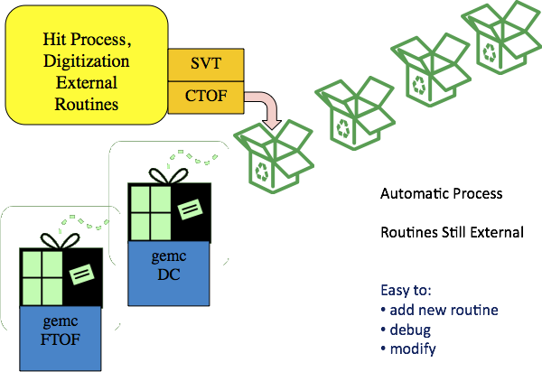
GEMC Digitization

Slide 34
GEMC Hit Sharing
156 m
multiple hits are possible / detector entity.
Example:
charge sharing in strip in silicon vertex detector
sensitive strip
sensitive strip
intermediate strip
100
45
45
100

Slide 35
The GEMC Project
2007: Geometry from DB
2008: Sensitivity, fields from DB
2009-2011: CLAS12 Baseline geometry, digitization
2011: CLAS12 All detectors upgrades geometry, digitization
2011: Background, Electronic Noise
2012: Material Factory
2012: Parameter Factory
2012: Geometry Factory
2012-2013: Signal as a function of time: FADC digitization

